Slide 1
Replacing 200 years of Physics with
- With Matrix Multiplications
Shivang Arora, Patryk Dabkowski
IQS Laboratory
WMI Winter Retreat| 05.02.2026

Slide 2
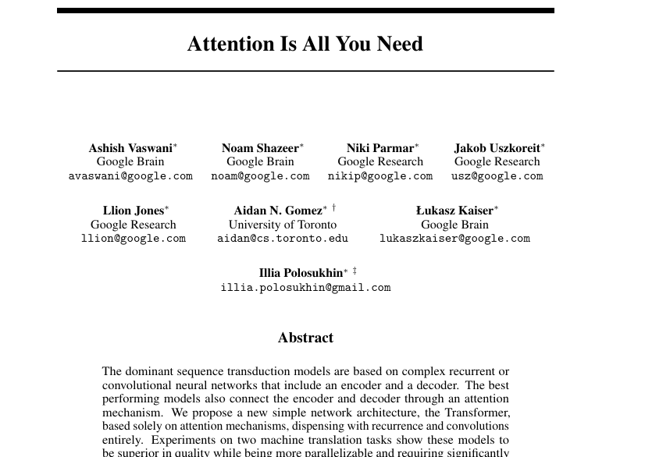
Outline
Self Attention Mechanism
Transformer Architecture
Exercises
We test our own GPT like model
Understand the shortcomings
Applications in Quantum Computing
Quantum Feedback Control of Transformer
Image source:

Slide 3
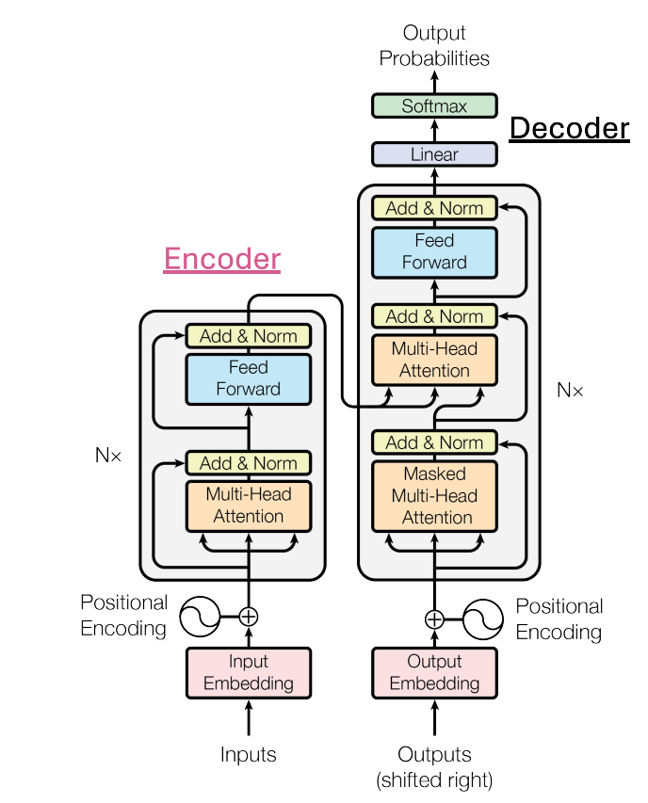
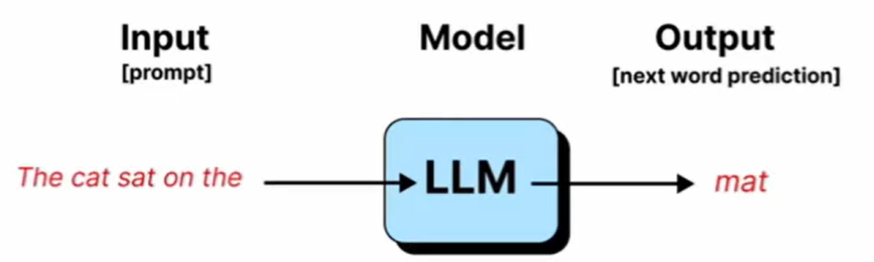
Transformer Architecture
Technology Behind Large Language Models that Allows:
Machine language translation
Next word prediction
Generate videos and music
A Transformer is an NN that repeatedly lets every token attend to every other token, decides which token is important for which token, and refines its representation.

Slide 4
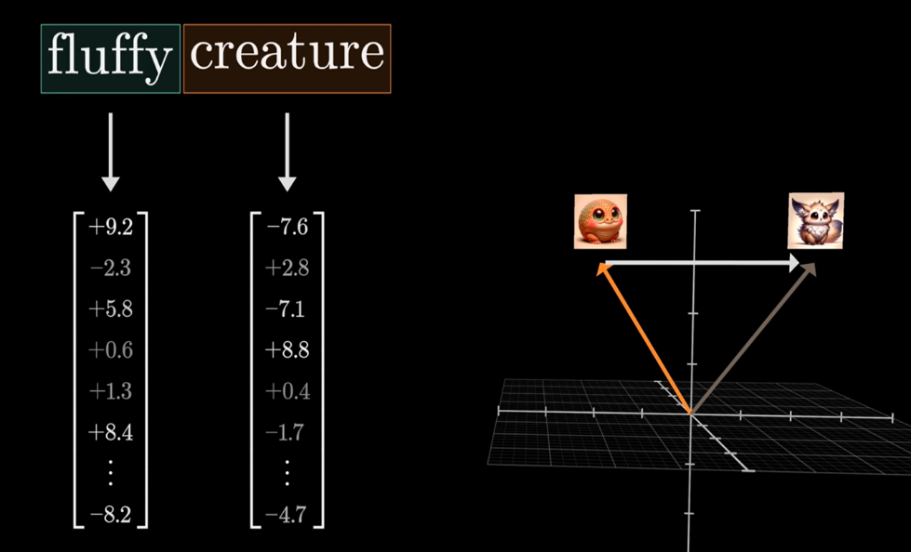
Tokens and Embeddings
Tokens:
Indivisible-units or entities that together form a vocabulary for the model.
Embedding:
Each abstract token is assigned a vector in a larger vector space.
This starting representation is known as the embedding.
The goal of training a model is so that it can refine the embeddings to always reflect the structure of language inside the vector space.
Image from Brańczyk et al 2012 New J. Phys. 14 085003.

Slide 5
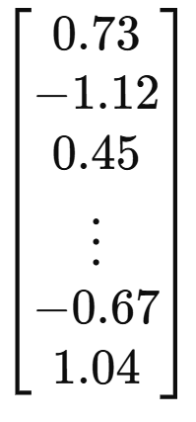
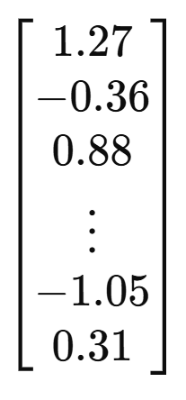
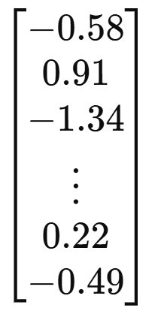
Embeddings (Initial + Positional)
A fluffy blue creature roamed
. . .
Add fixed vectors based on the index
So the embedding fed to the transformer takes into account order.
The dog ate the chicken.
The chicken ate the dog
Pos 1 Pos2 Pos3 Pos4 Pos5

Slide 6
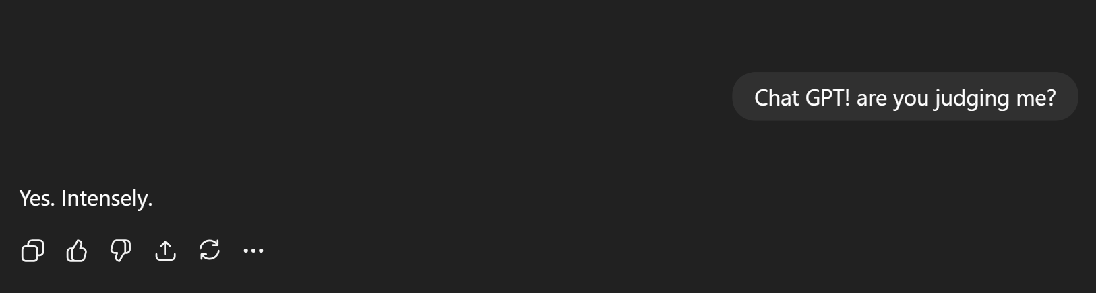
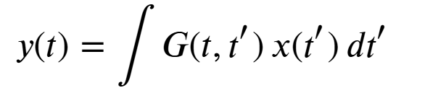
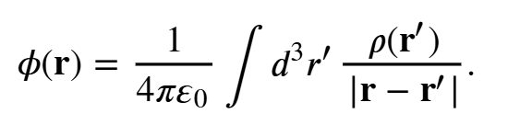
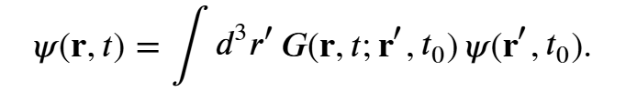
Attention Mechanism
All of physics is written in this language
The kernel G tells us what locations are important for the present state or observable y.
You → Chat GPT
Chat GPT → Judging ← Me
Attention : A systematic method with which it can assign importance of previously seen words for the prediction of next word.

Slide 7
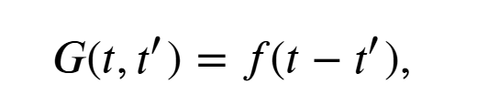
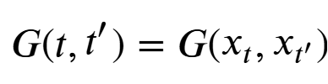
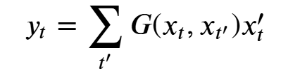
Attention - Kernels
Attention as a Context Dependent Kernel
We simplify physical systems by assuming certain constraints on G.
Time Translational Invariance
Transformers make the Kernel context dependent. i.e the relative importance does not just depend on the location but also what was the token at that location.
Kernel Independent of token
Kernel depends on x at t and t’

Slide 8
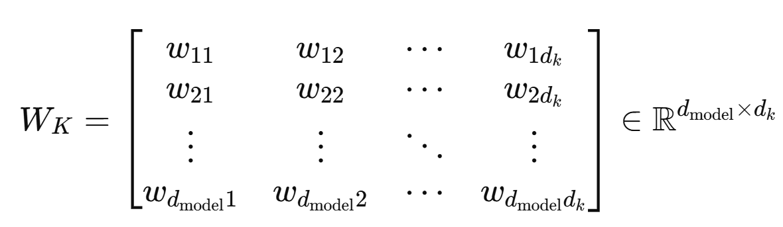
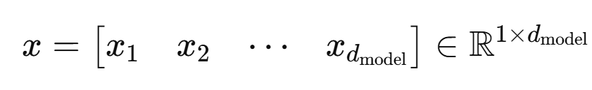
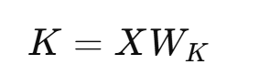
Key and Query Representation
Instead of having just one representation, each word also gets a Key (K) and Query (Q) representation.
A word’s ‘Query’ representation is used when we are looking for words that attend to it.
When the same word appears as a context to some other word, then we use it’s ‘Key’ representation.
You → Chat GPT
Chat GPT → Judging ← Me
For each token embedding x , we multiply or project it by a matrix W_K.
Iteratively learned through gradient descent!

Slide 9
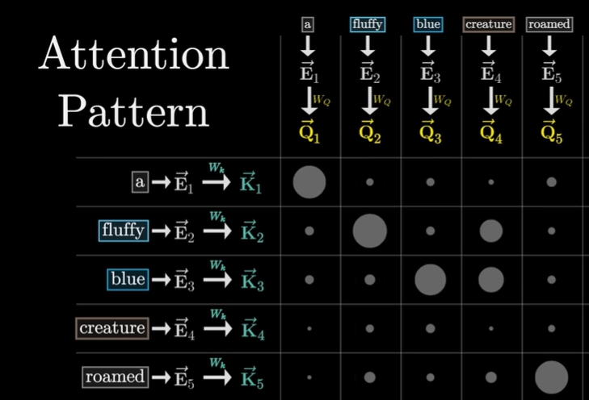
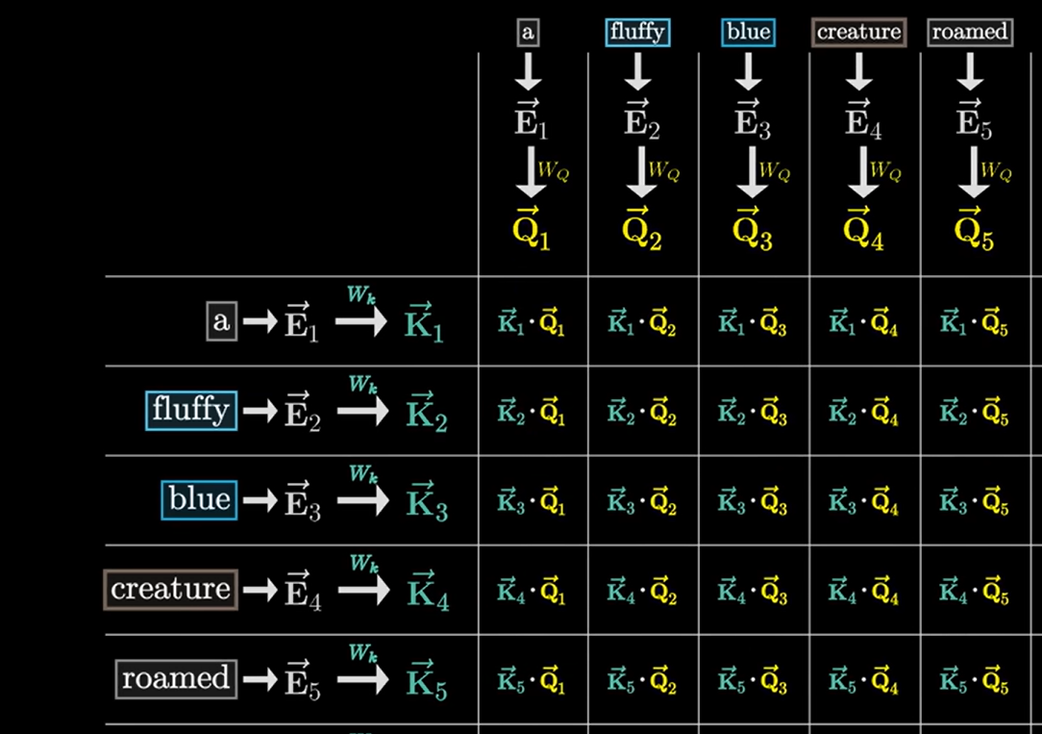
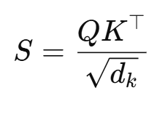
Attention Matrix (Kernel)
Example : A fluffy blue creature roamed.
Trained Attention Kernel detecting adjective-noun relationship
Torlai, G., et al. (2018). Neural-network quantum state tomography. Nature Physics, 14(5)

Slide 10
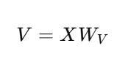
Update Representation (Value vector)
After each pass through the attention layer, the embeddings become more and more meaningful.
Based on this attention matrix each token/word is now assigned a new vector in the large vector space. A third representation called the Value (V) representation is used for this.
Value Vector
Embedding

Slide 11
Exercise: Evaluate the Attention Matrix

Slide 12
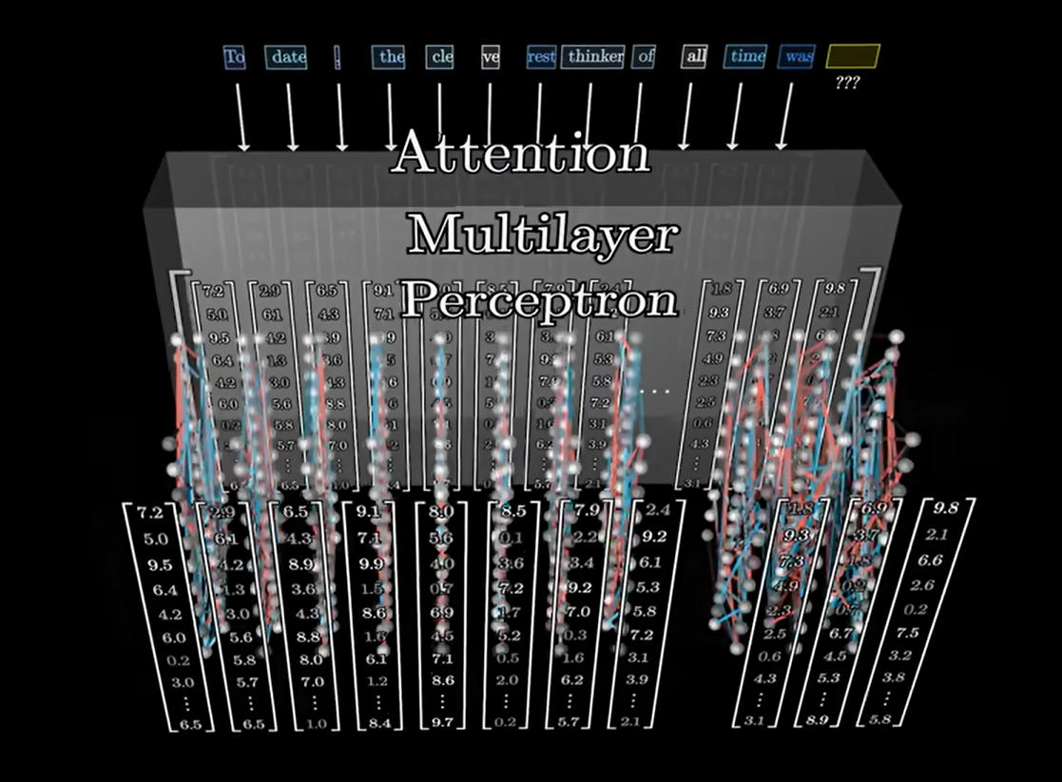
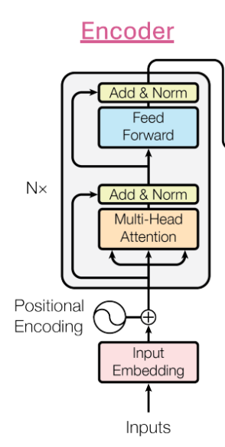
The Encoder
The result of the Attention block is fed to a Feedforward Neural Network.
Through the FNN, a richer context is now added to the tokens.

Slide 13
Exercise: Single Layer Encoder

Slide 14
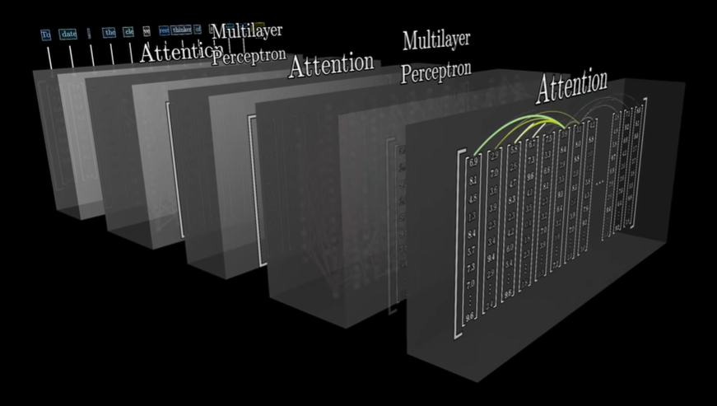
Full Encoder

Slide 15
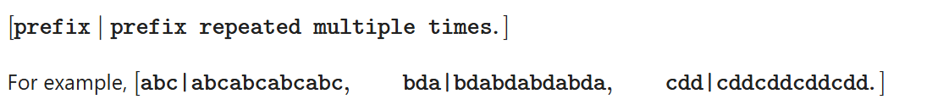
Exercise: Train your own GPT
Task: Make a model learns to detects at tokens before | and repeats them

Slide 16
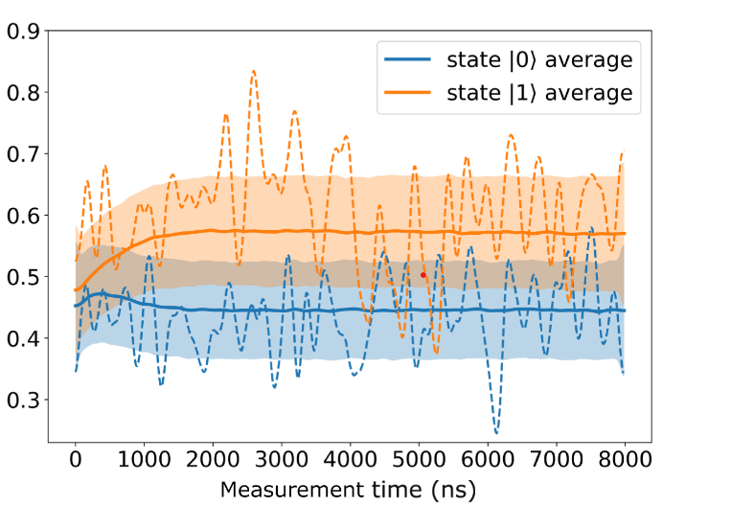
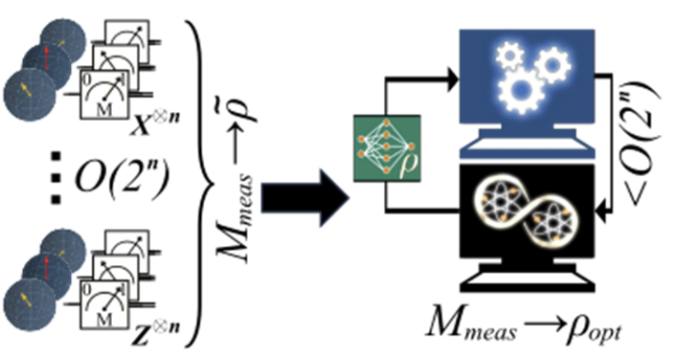
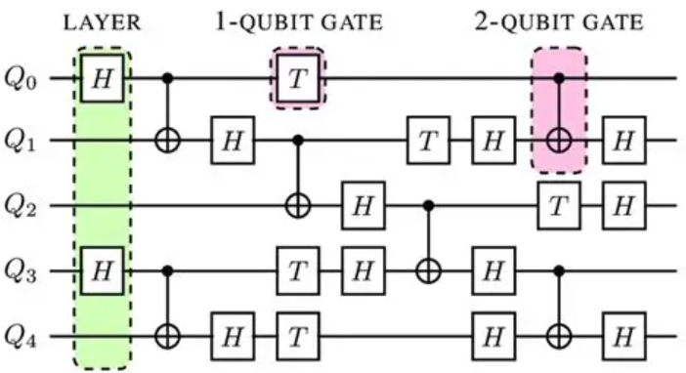
Applications for QC
If Attention Learns Language, What Could It Learn About Quantum Systems?
Control and design of any complex system is just a bunch of sequences.
Multiplexed Readout Classification
Adaptive Tomography (Predict Next Ideal Measurement Basis)
Transformers as Circuit Compilers
Logical circuit -> Hardware compatible pulse sequence
Use current knowledge of system drifts and hardware constraints (connectivity)
Transformer takes into account current calibration data

Slide 17
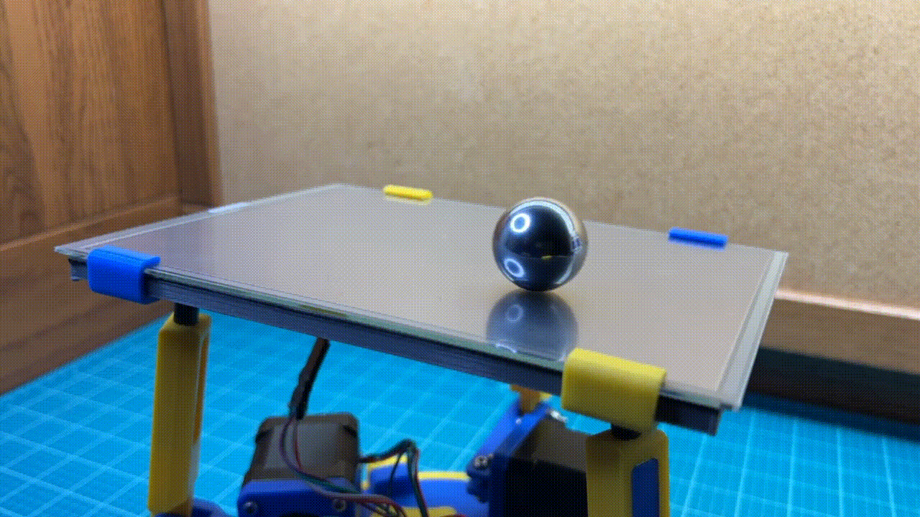
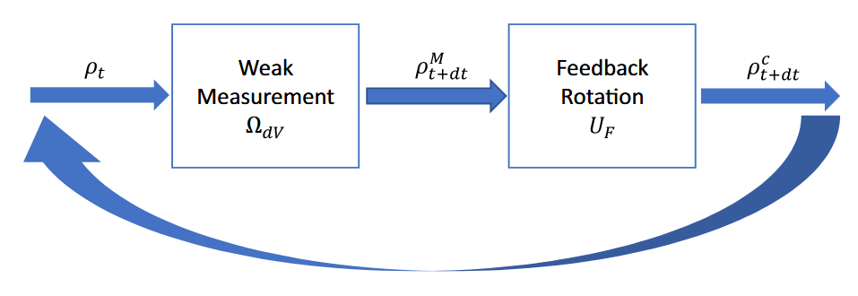
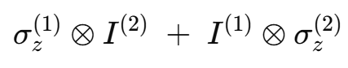
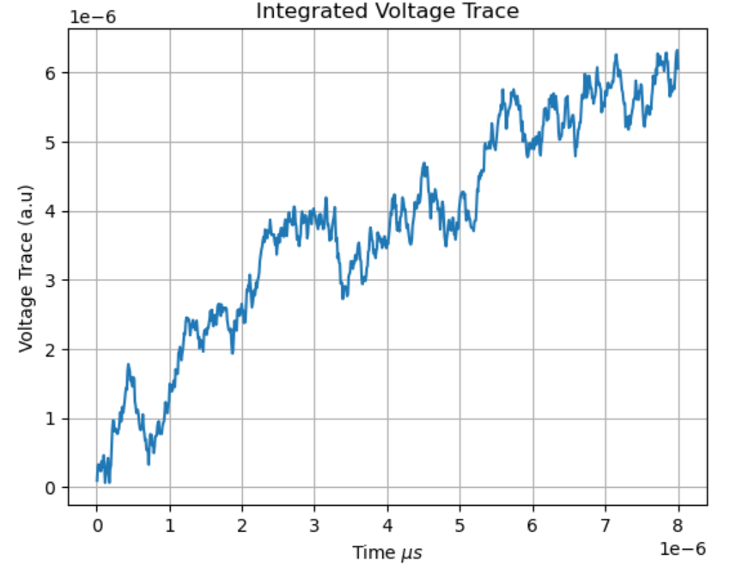
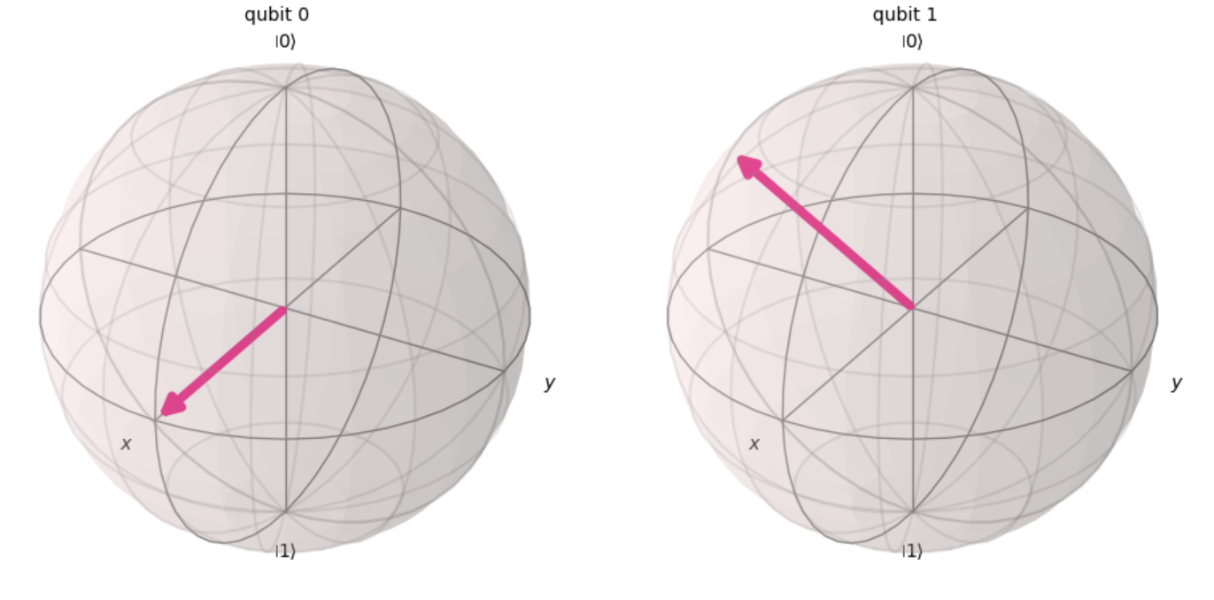
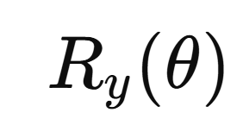
Applications for QC
Feedback Control of a Qubit with Weak Measurements
We dispersively monitor the qubits.
Based on the voltage at time t, apply a Y-rotation of equal strength on both qubits based on the result.

Slide 18
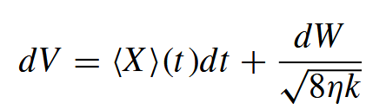
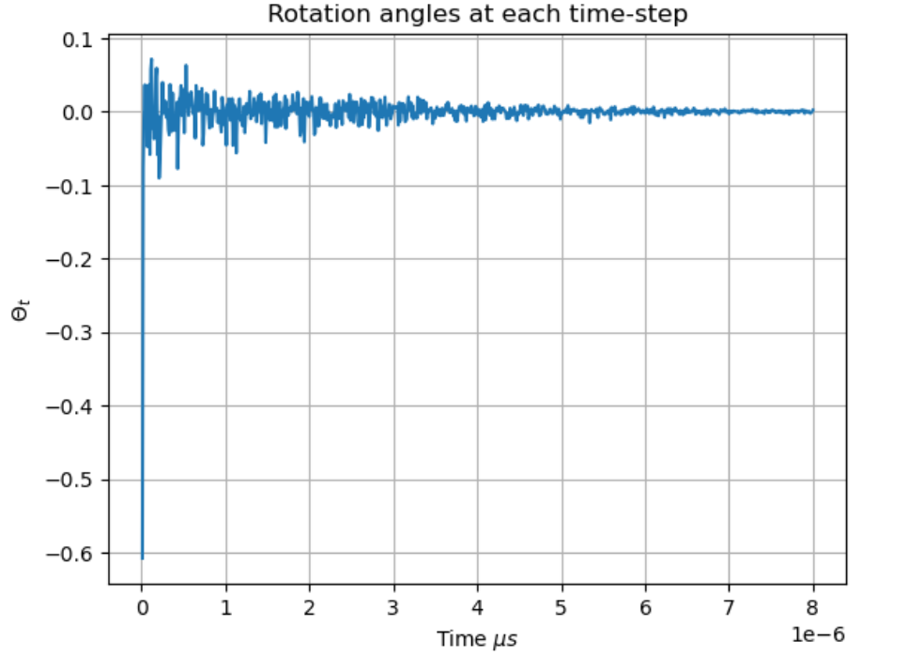
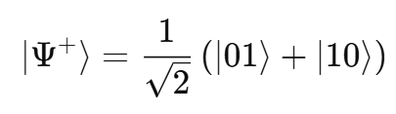
Applications for QC
Feedback Control of a Qubit with Weak Measurements
(Observable estimate + Wiener noise)
Evaluate the optimal controls

Slide 19
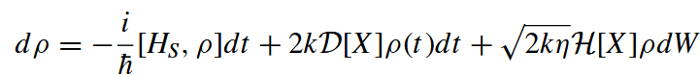
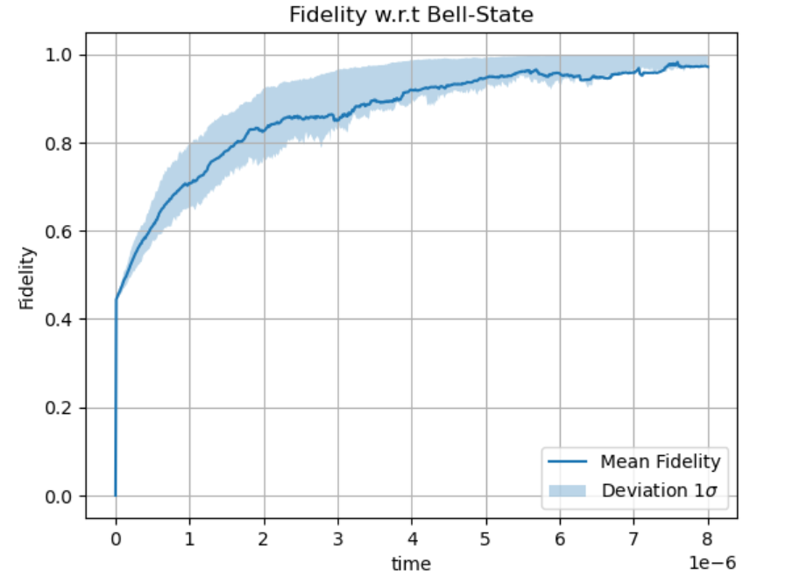
Applications for QC
Feedback Control of a Qubit with Weak Measurements
Traditional Approach
Optimal rotation angles can be found by solving the master equation and doing some intensive computations.
Limitation
Several approximations need to be made to make it efficient and realistic for real time implementation
Exact knowledge of the system Hamiltonian is required
Dynamics based on measurement record is Non-Markovian.

Slide 20
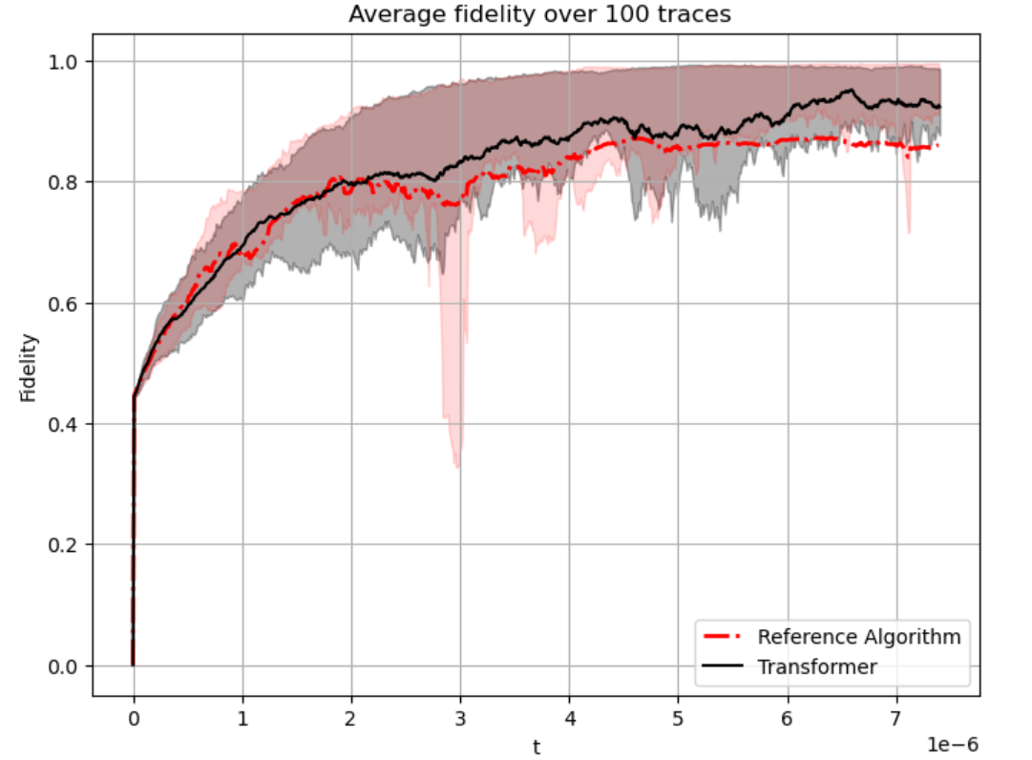
Applications for QC
Feedback Control of a Qubit with Weak Measurements (Transformer)
Learn to predict the right feedback based on the past history
Performance with Random Qubit Frequency Drifts
Train on many examples of simulated data where full Master equation is solved with different calibration biases.
Transformer learns to predict Actions from Voltages in a model-independent way without explicitly referring to system Hamiltonian.

Slide 21
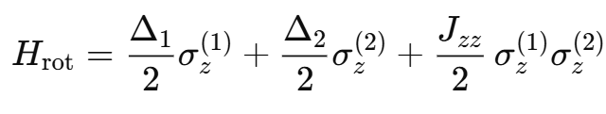
Applications for QC
Feedback Control of a Qubit with Weak Measurements (Transformer)
Advantages
Performance potentially more robust to calibration offsets and frequency drifts
As the number of qubits scales , this offers a more experimentally feasible method than solving the full master equation .
Robustness to random frequency drifts

Slide 22
